Slide 1
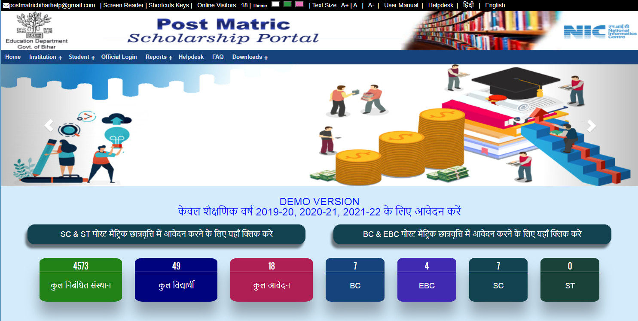
Welcome Page
Click here For Read Full Guidelines Before Student Registration

Slide 2
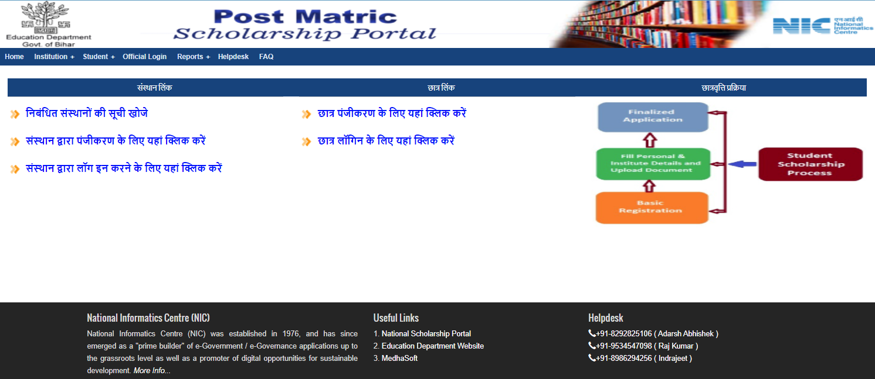
Student Registration(Step-2)
Click here

Slide 3
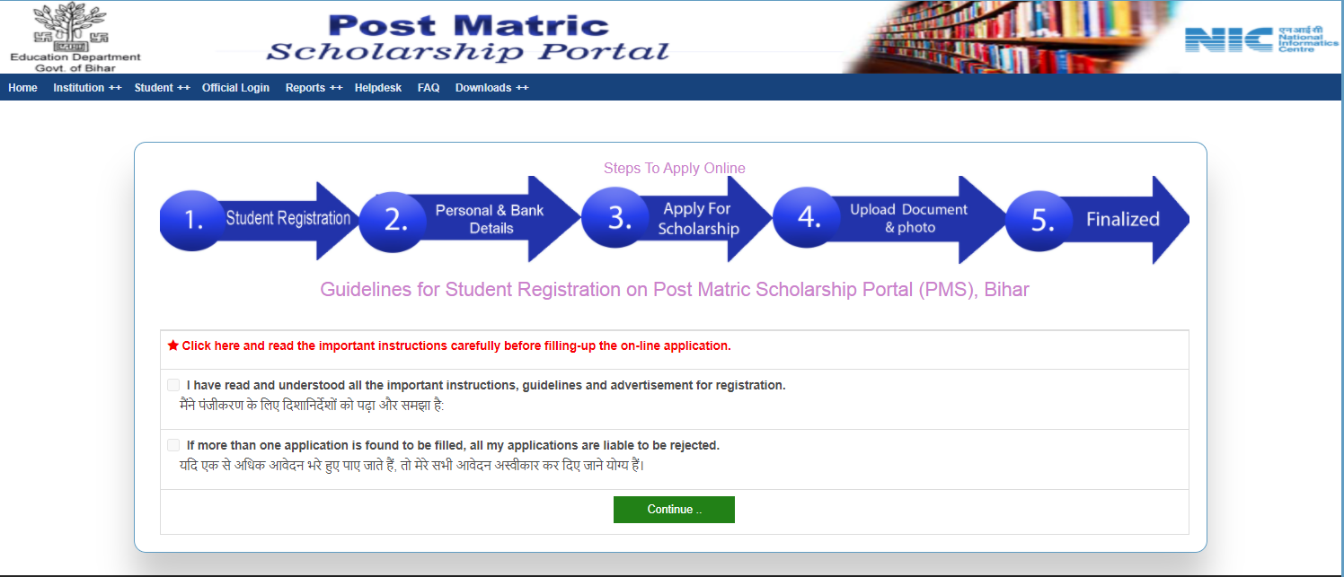
Guidelines for Student Registration
Read All Guidelines

Slide 4
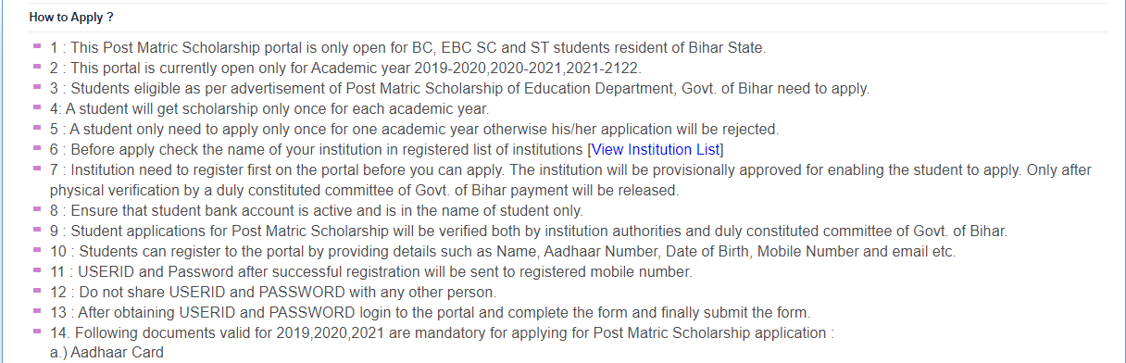
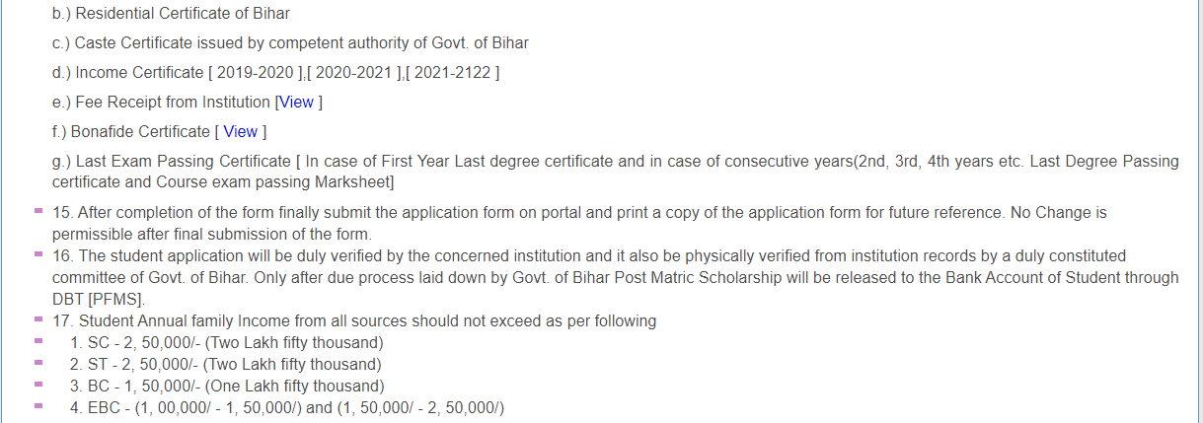
Student Registration(GuideLines)

Slide 5
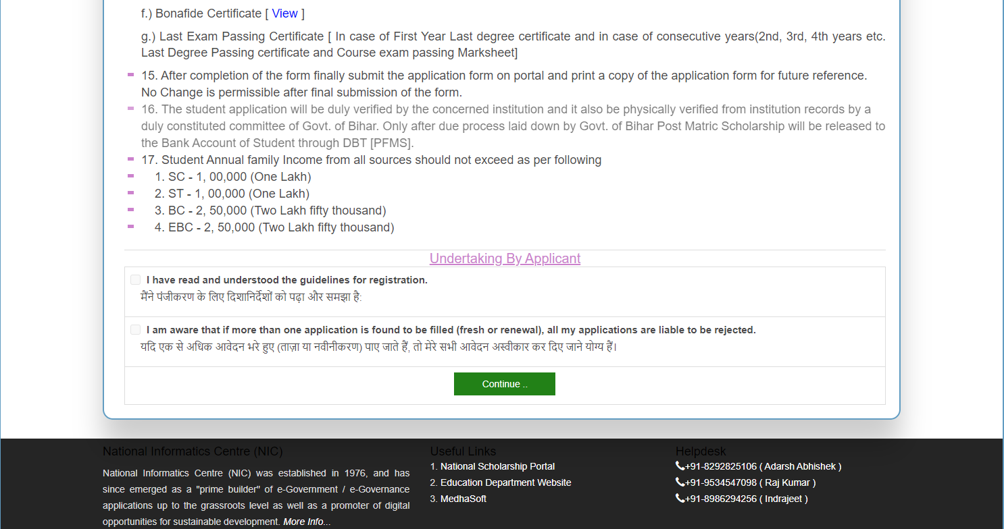
Student Registration(Page-2)

Slide 6
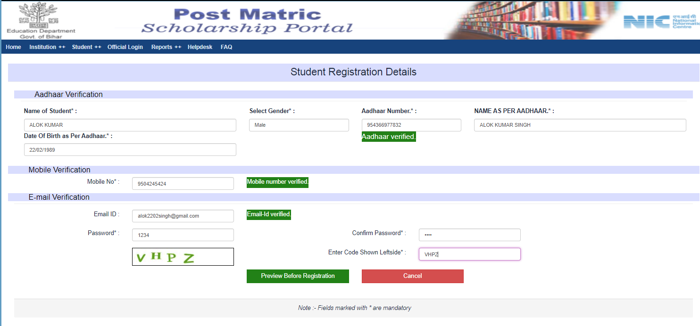
Student Registration(New)

Slide 7
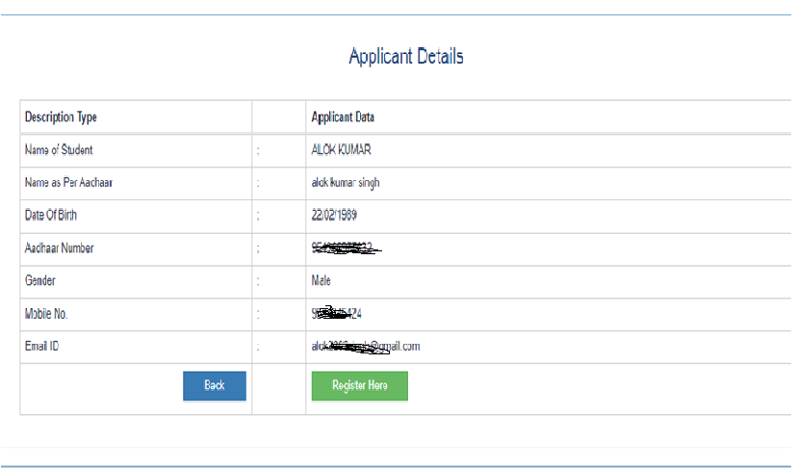
Student Registration(Preview data before Confirm Registration)

Slide 8
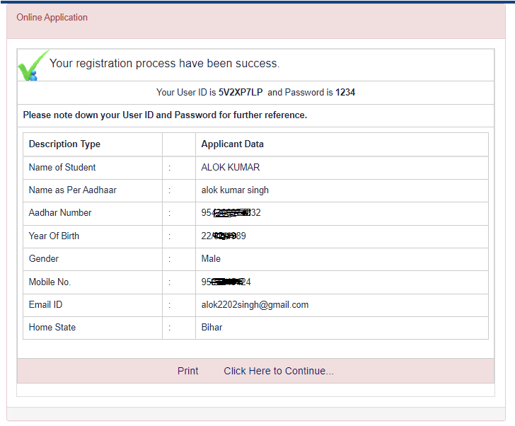
Registration Success Page

Slide 9
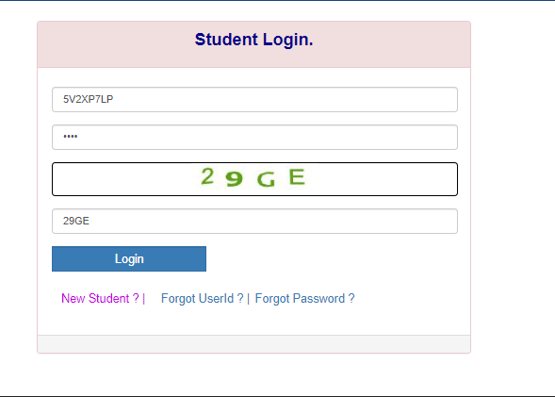
Student Login

Slide 10
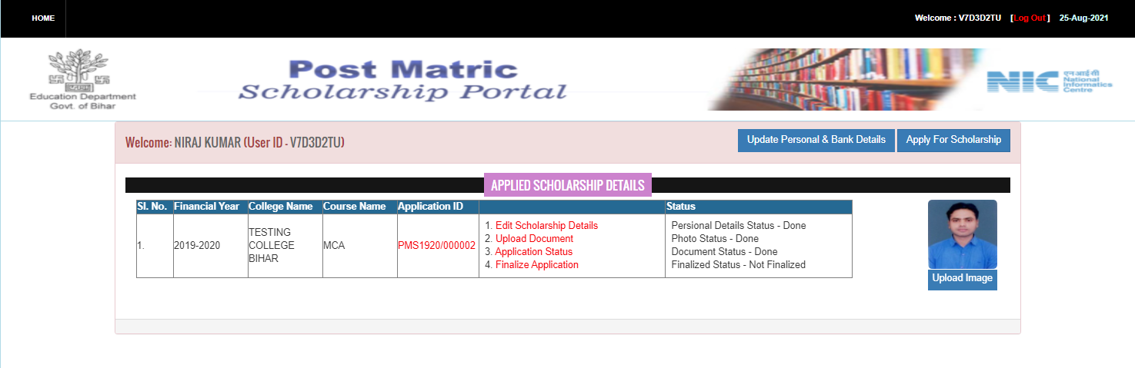
Student Welcome Page
Fill Student And Personal Details

Slide 11
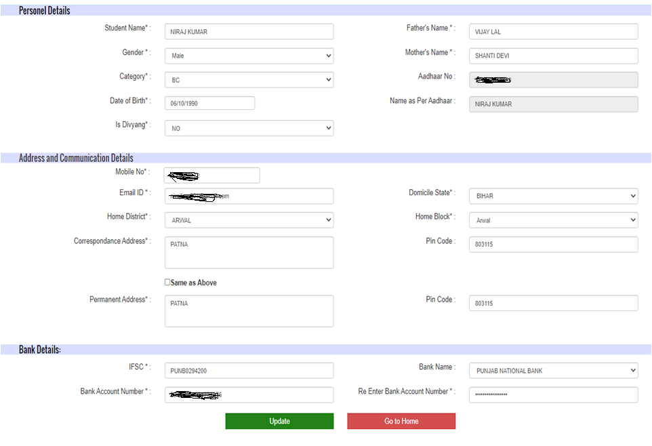
Student Personal & Bank Details

Slide 12
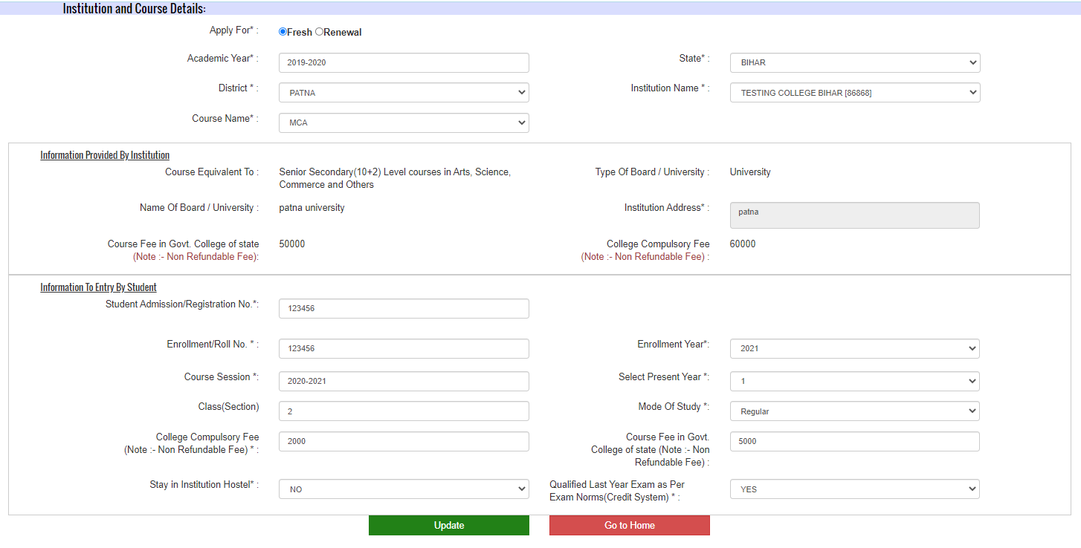
Institution And Course Details

Slide 13
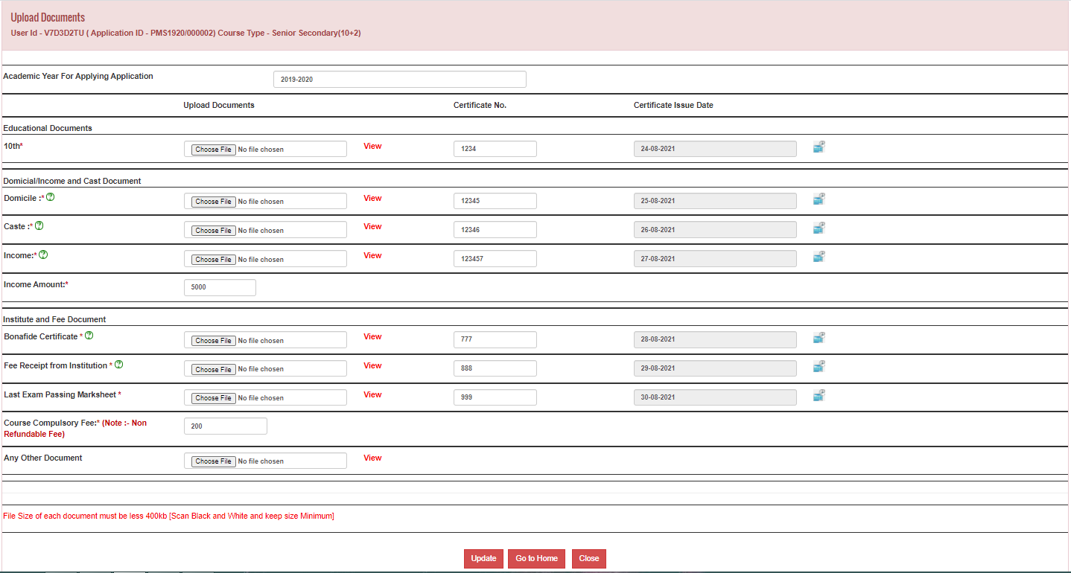
Upload Documents

Slide 14
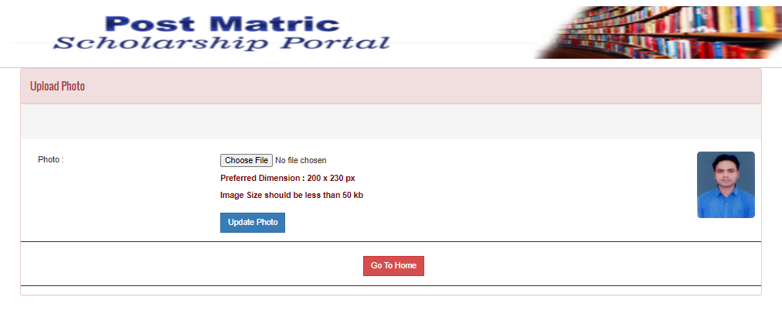
Upload Photo

Slide 15
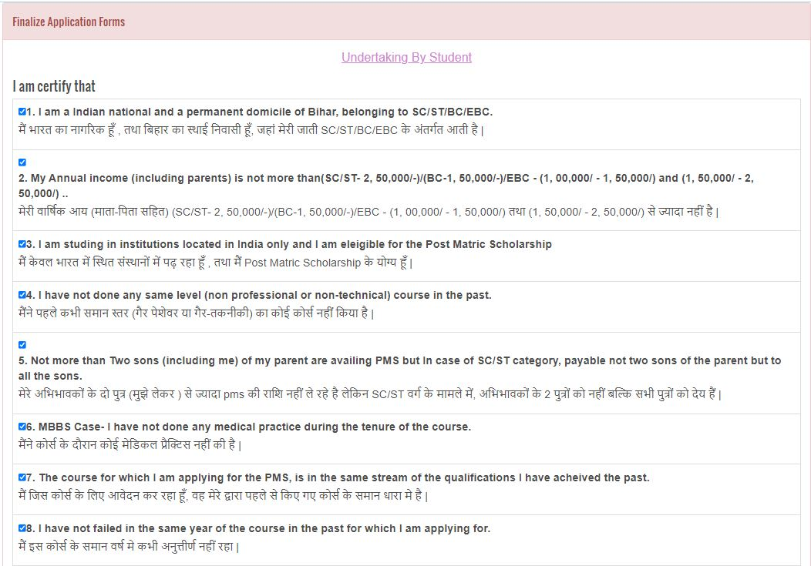
Finalized Application (page-1)

Slide 16
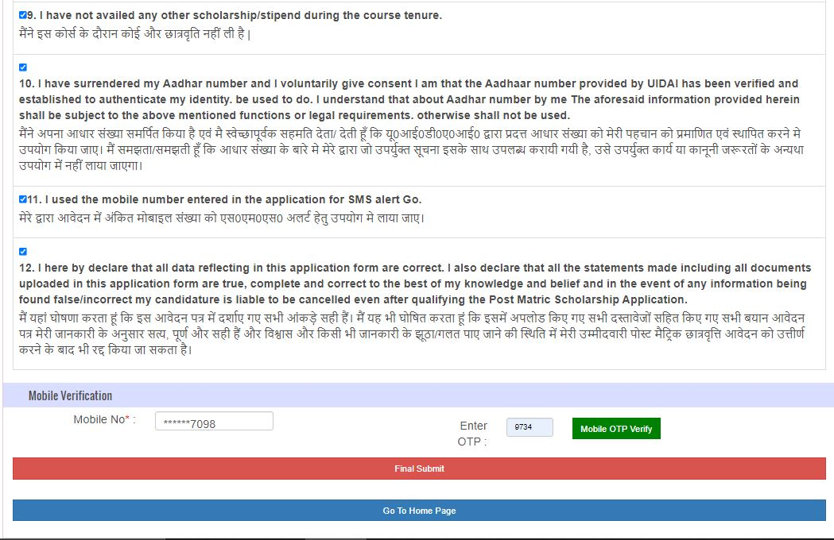
Finalized Application (page-2)

Slide 17
After Finalized Application

Slide 18
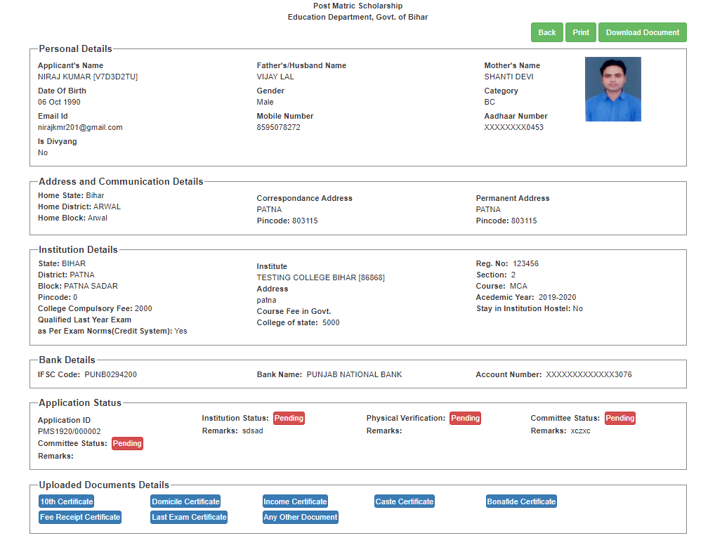
Application Status

Slide 19
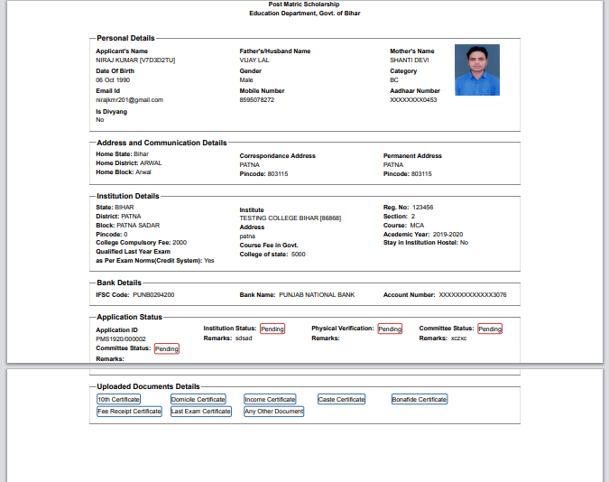
Print Application Form

Slide 20
Thank You

