Slide 1
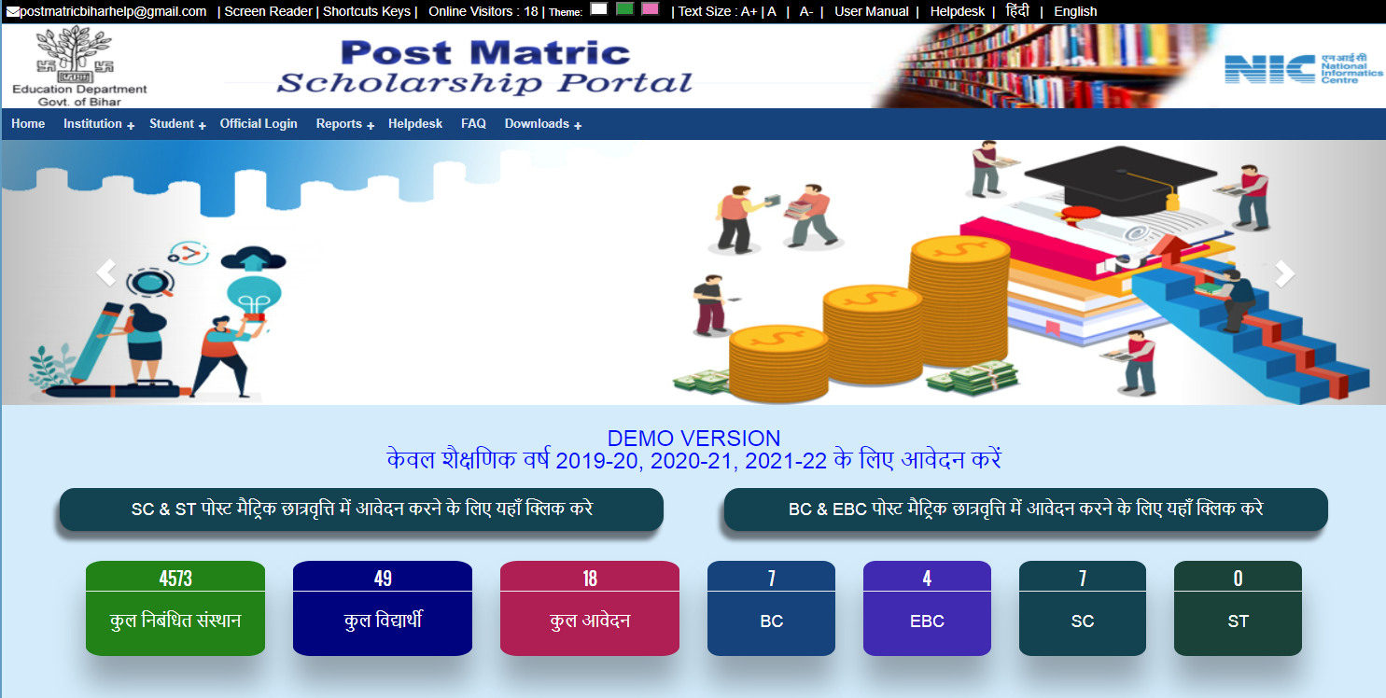
Welcome Page

Slide 2
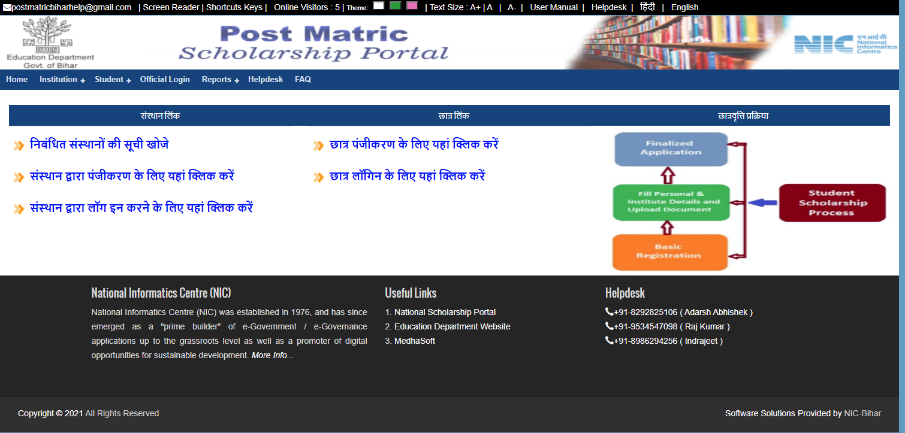
Institution and Student Registration Link
Student Registration
Institution Registration

Slide 3
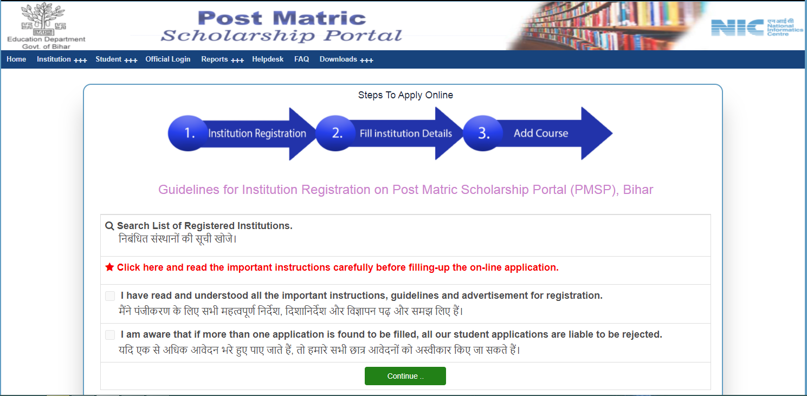
Guidelines for Institution Registration
Click here For Read Full Guidelines

Slide 4
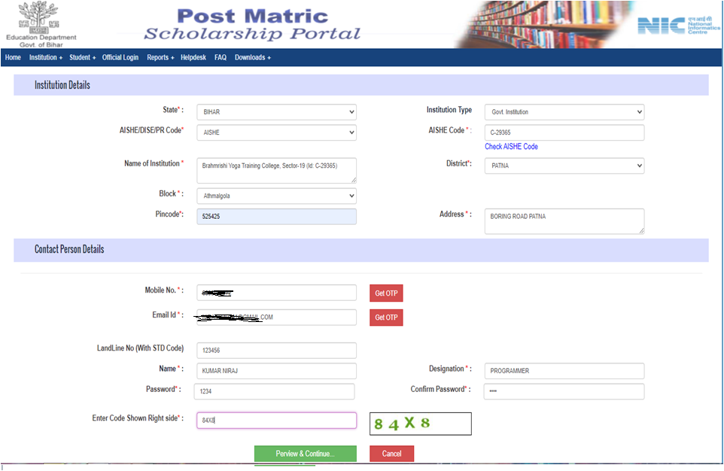
Institution Registration (Part - 1)

Slide 5
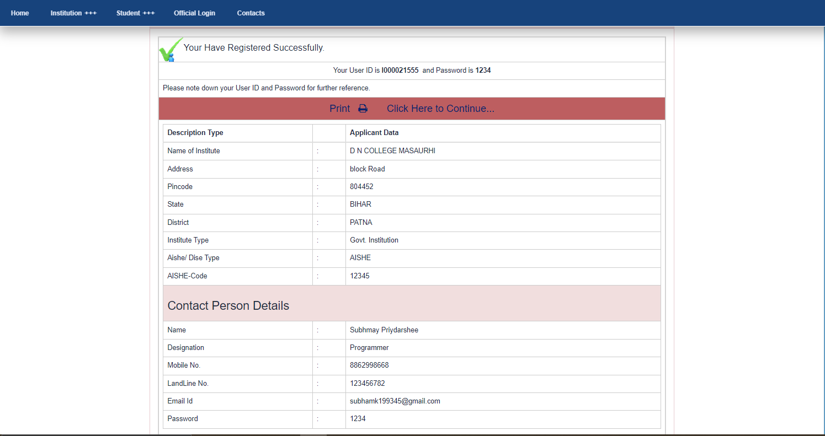
Registration Success Message

Slide 6
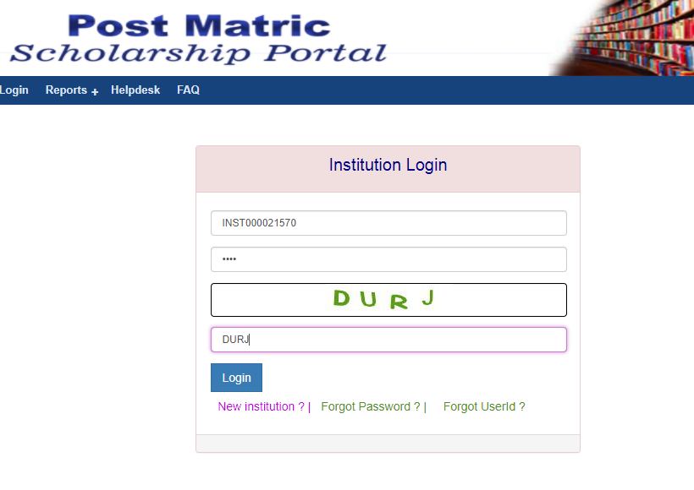
Institution Login

Slide 7
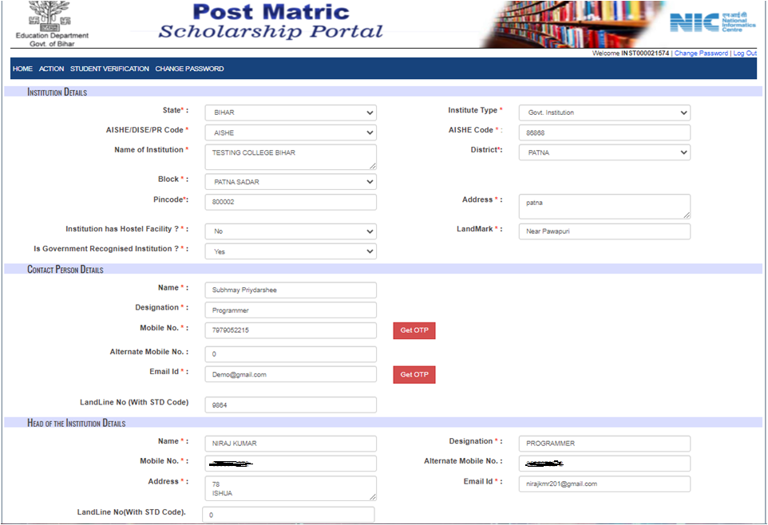
Update Institution Profile Details

Slide 8
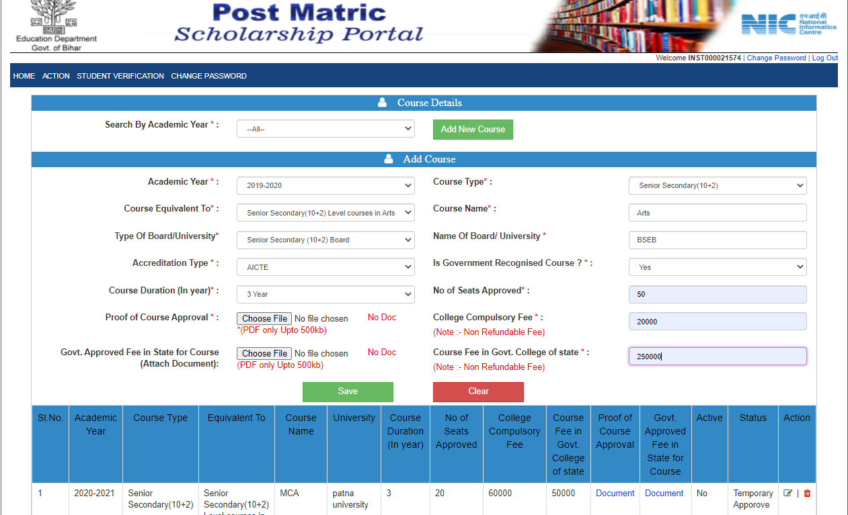
Add Course Details

Slide 9
Thank You

